Slide 1

MSc in Computational Data Science
Enhancing the methodological approach to Systematic Literature Reviews: A practical application on Topic Labeling research
Candidate: Samuele Ceol
Supervisor: Barbara Russo
July 2023

Slide 2
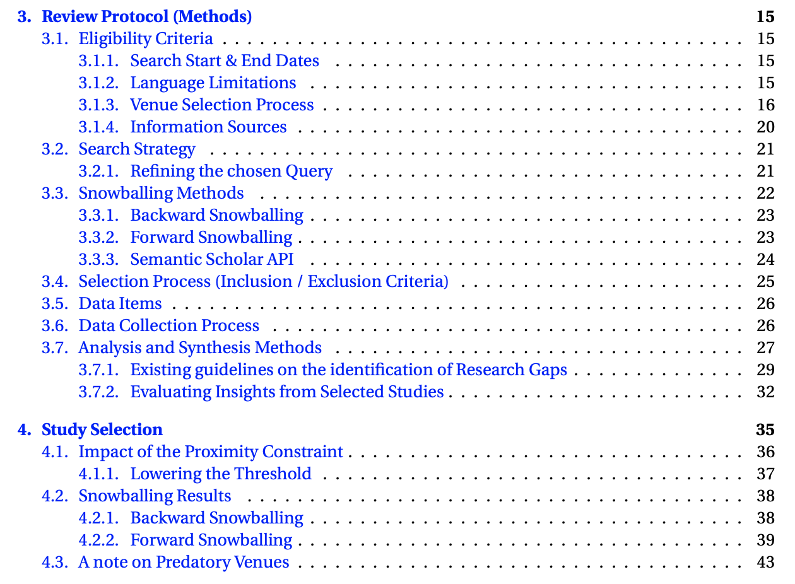
Rationale
Addressing the lack of SLRs focusing on topic labeling
Reviewing the relevant primary studies in the period 2017-2022
Sharing a set of methodological contributions formulated from observations made throughout the review process
Capable of enhancing (parts of) existing guidelines for conducting secondary studies (SEGRESS - Kitchenham et al., 2022)
Believed to be generally applicable outside of the investigated domain
Notes:
Firstly, the development of this work stemmed from our desire to address…
2. Additionally, throughout the development of this secondary study we formulated and applied a set of m.c. …
-
Software Engineering Guidelines for REporting Secondary Studies

Slide 3
Summary of methodological contributions
Gathering the primary studies
Using the numerical results stemming from three queries to identify the most appropiate venue search procedure
Grounding the venue selection process on established quality metrics
Introducing the use of a proximity operator in the search strategy and analysing the impact of the imposed constraint on the collected documents
Employing a quality-based filtering step in the forward snowballing activity
Verifying the presence of predatory venues
Analysing the primary studies
Structuring the analysis and synthesis into a three-tier architecture
Grounding the provision of individual methodologies on the basis of its accessibility and reproducibility
Exploiting in the data collection process external tools to highlight salient portions of the inspected work
Setting up the initial methodological structure for producing literature networks
Notes:
SEGRESS: Software Engineering Guidelines for REporting Secondary Studies

Slide 4
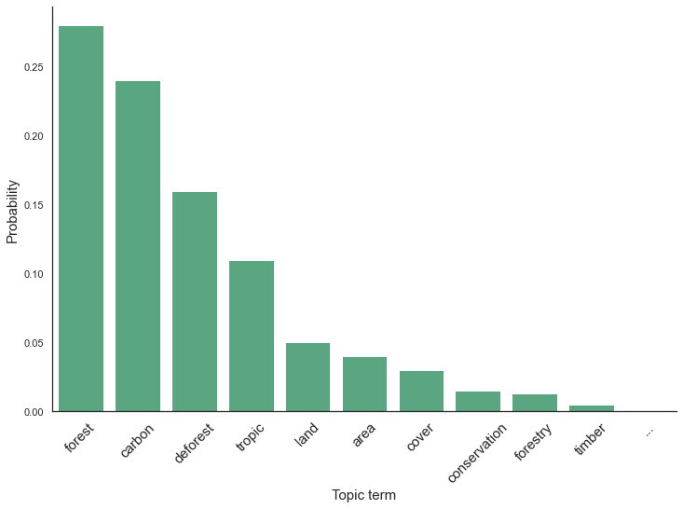
Definitions
Topic modeling: “a text mining […] method that extracts topics from large corpora of textual documents to discovery hidden [i.e. latent] semantic structures in text” - Silva et al. (2021)
Topic: A probability distribution over a fixed vocabulary (often represented via the most prominent terms)
Topic labeling: Task of pairing each topic with a label capable of concisely summarising its content
Topic label: “a sequence of words which is semantically meaningful and covers the latent meaning of the topic. Words, phrases, and sentences are all valid labels under this definition” - Mei et al. (2007)
Label: Forest conservation
Notes:
A topic shows the hidden relation between words in a vocabulary and their occurrence in our corpus of documents.
(words that tend to vary together belong to the same topic)

Slide 5
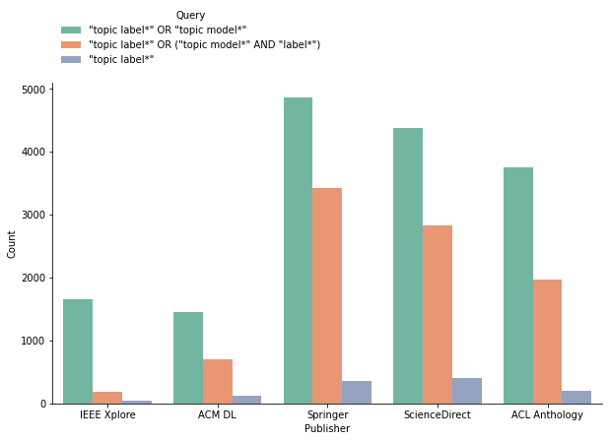
Venue selection process
Exploratory search is conducted on 5 repositories:
IEEE Xplore, ACM Digital Library, SpringerLink, ScienceDirect & ACL Anthology
Three candidate queries proposed for this purpose
Ultimately, one is selected to identify the relevant venues
, each yielding a set of numerical results

Slide 6
Venue selection process
A search is conducted on 5 literature repositories:
IEEE Xplore, ACM Digital Library, SpringerLink, ScienceDirect & ACL Anthology
Relevant venues are identified based on:
The number of associated documents
Selected quality metrics
Scimago Journal & Country Rank (SJR(2)) score
Computing Research and Education Association of Australasia (CORE) rating
GII-GRIN-SCIE (GGS) rating
Notes:
…associated documents retrieved on the basis of the proposed query

Slide 7
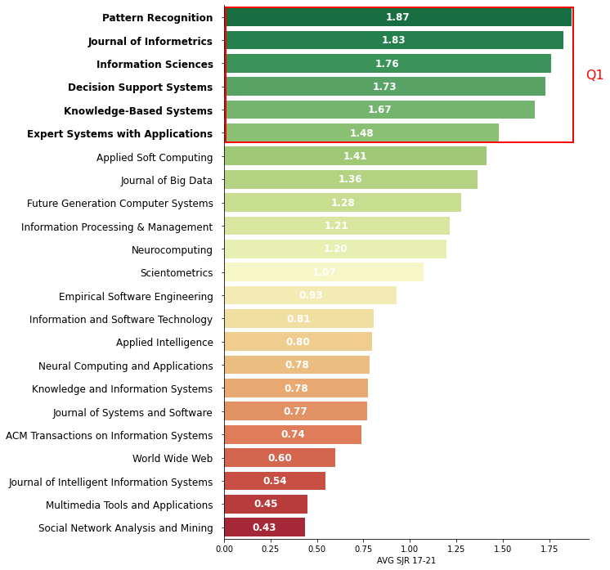
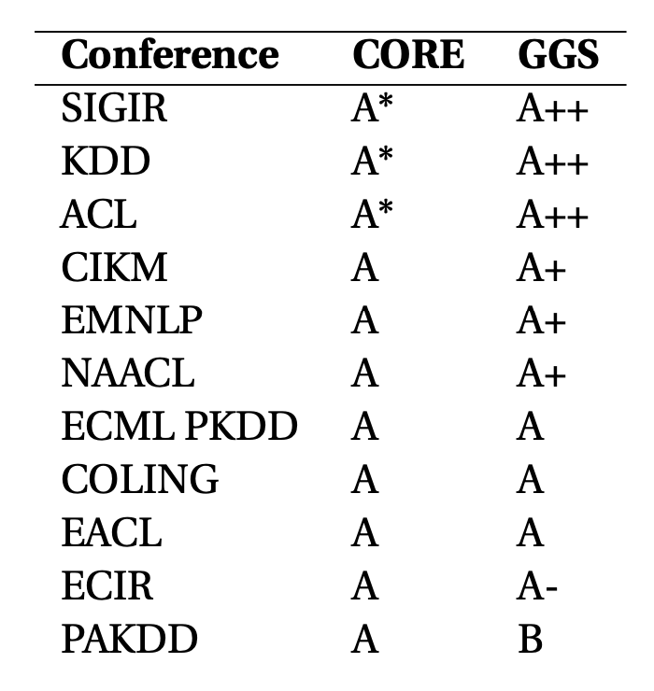
Venue selection process
Results:
6 journals
10 conferences

Slide 8
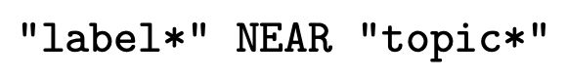
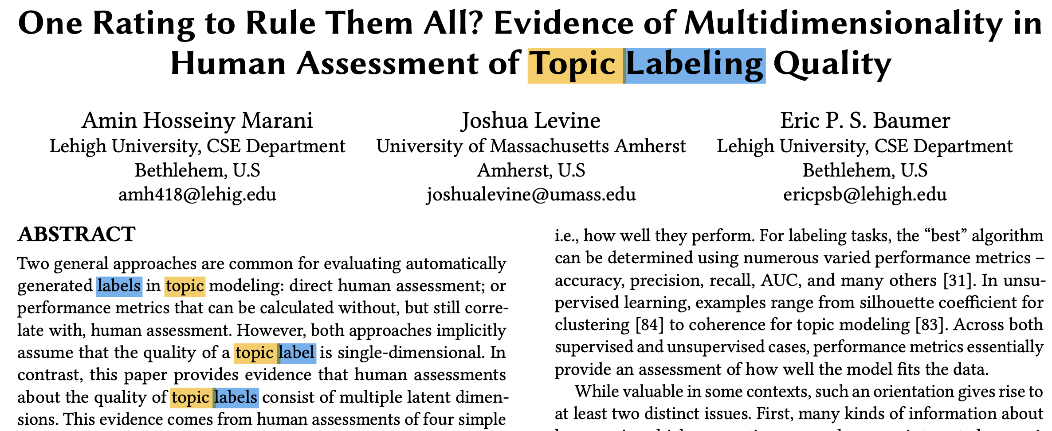
Search strategy
Strategy employed in the venue selection process is extended by means of a proximity operator:
And used to identify the relevant primary studies
Proximity constraint is set to 20 terms
“The average length of sentences in scientific writing is only about 12-17 words” - Griffies et al. (2013)
Notes:
Mention why the query is split in two parts

Slide 9

(Initial) Study selection
424 primary studies are collected
201 conference and 223 journal papers
Inclusion\exclusion criteria are applied by means of manual inspection
Only studies actively applying topic labeling techniques are kept
Secondary & tertiary studies are filtered out
…
A core selection of 55 papers is obtained
Representing the first set of studies included in the review
Initial collection
55

Slide 10
Inclusion/Exclusion criteria
Selected studies should propose or actively apply, either with a primary or secondary focus a topic labeling technique
Papers appearing in the selected research do not necessarily need to describe the implementation of a novel labeling approach, but it is important that they do not meet any of the following exclusion criteria:
The paper does not actively apply any topic labeling techniques.
The labels do not posses descriptive properties with regards to the specifics of the topics’ content.
All the described labeling approaches are taken from existing work and re-proposed as-is (on the same corpus and set of topics).
The paper and/or the analysed corpus do not match the imposed language restrictions.
The paper is a Systematic Review (secondary/tertiary study).

Slide 11
Snowballing activities
Scope of the review is extended by extracting:
References (backward snowballing)
Citations (forward snowballing)
This additional work is filtered via the defined search strategy
And the inclusion/exclusion criteria are applied
A further quality-based filtering step is performed on the forward snowballing studies
B.S.
Initial collection
F.S.
References
Citations
738
55
1147
160
30
358
23
58

Slide 12
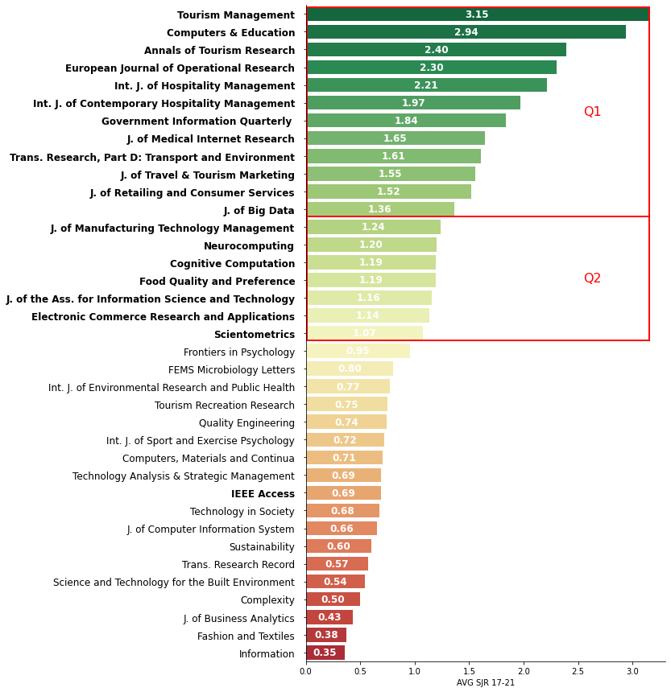
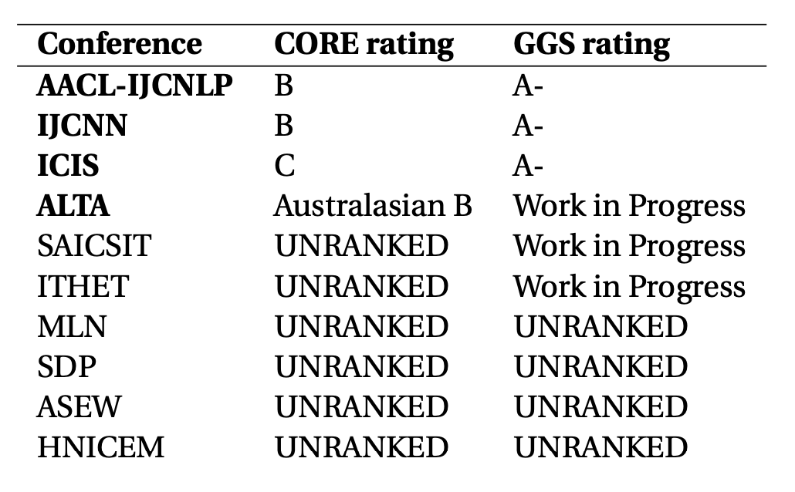
Snowballing activities
F.S. work is further filtered based on the quality of the associated venues
SJR(2) score for journals (Avg score of 1 and above)
CORE/GGS ranking for conferences
Notes:
For B.S., qualitative properties of the core collection are expected to carry over to the referenced work
For F.S., no a-priori assumption of quality can be made for the gathered citations

Slide 13
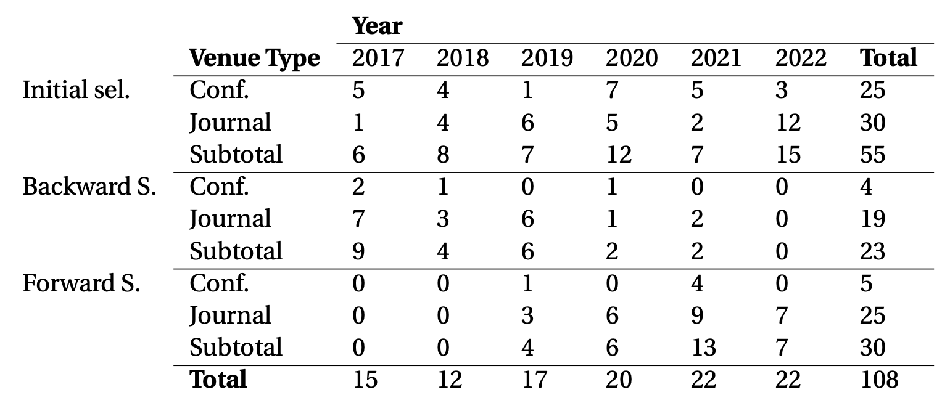
Study selection
A selection of 108 papers is ultimately obtained
B.S.
Initial collection
F.S.
References
Citations
23
55
30
Notes:
Mention check on predatory venues

Slide 14
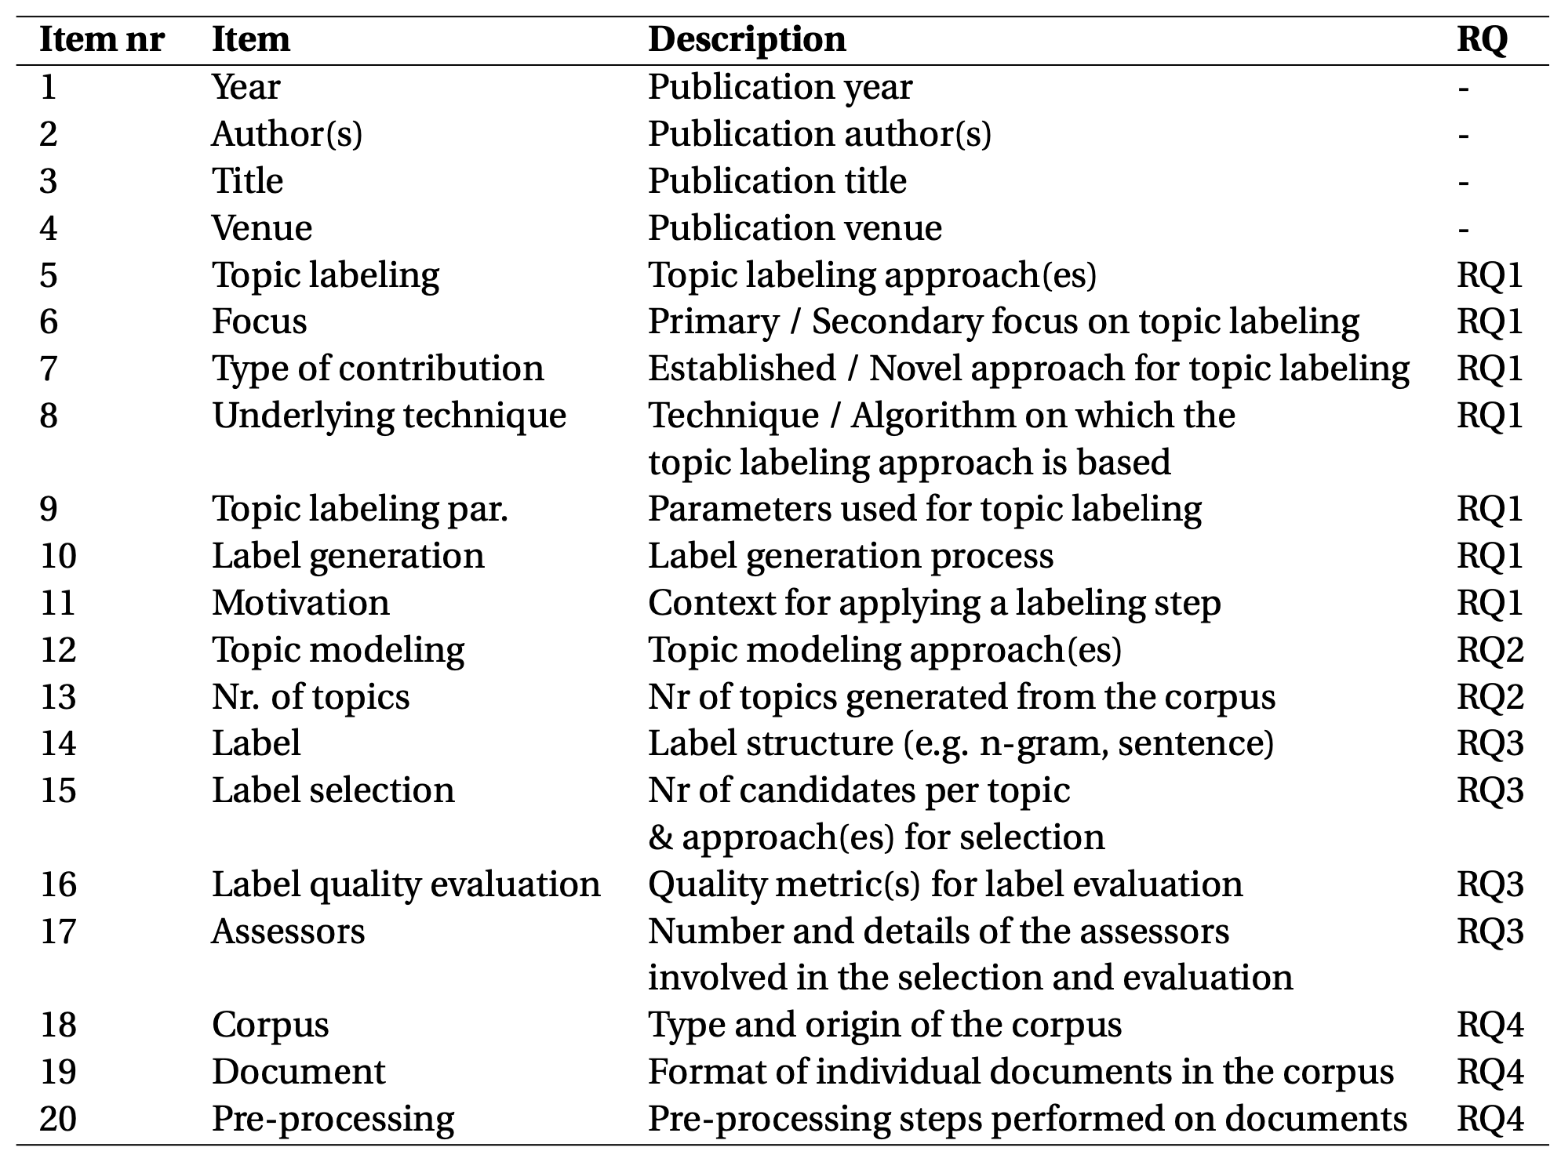
Data items & Research questions
The data collection process is centered around data extraction forms
Establish which information is relevant for the review (what to look for in primary studies)
Made up of 20 data items
Tie each group of items to a specific research question
Research questions seek to profile the domain of interest in terms of:
Identified categories of labeling approaches and techniques by which they are implemented
Topic modeling approaches
Observed label structures and conducted quality evaluation procedures
Characteristics of the underlying corpora
Notes:
Intuitively, a data extraction form is populated for each of the included studies

Slide 15
Structure of the analysis and synthesis
The analysis of the collected data is structured into three phases:
A synthesis of the primary studies
Presented following the defined data items
Highlighting the encountered contents and methodologies
Addressing the posed research questions
A description of the identified research gaps
Selected insights from individual studies
Offered to provide guidance to prospective researchers

Slide 16
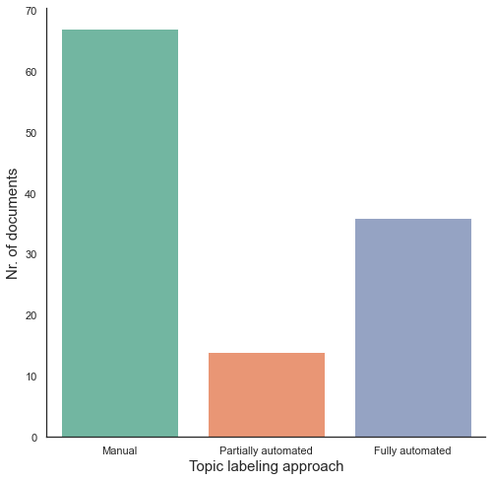
RQ1 – Topic labeling approaches
Categories of manual, partially automated and fully automated approaches are identified
Additionally:
~75% of documents show a secondary focus on topic labeling
Only ~35% ultimately introduce novel labeling techniques
Notes:
As a first step in analysing the collected data…

Slide 17
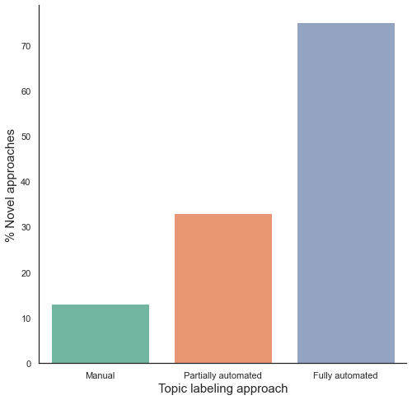
RQ1 – Topic labeling approaches
Novel methodologies are more prominent in documents including fully automated approaches
Notes:
Primary focus -> Mention of labeling in title/abstract/introduction
Most studies show a secondary focus on topic labeling -> 75% -> Expected given the application of the query to the entire body
Non-novel approaches are favoured in most studies -> 64% -> Manual labeling is also not considered novel (in most cases)

Slide 18
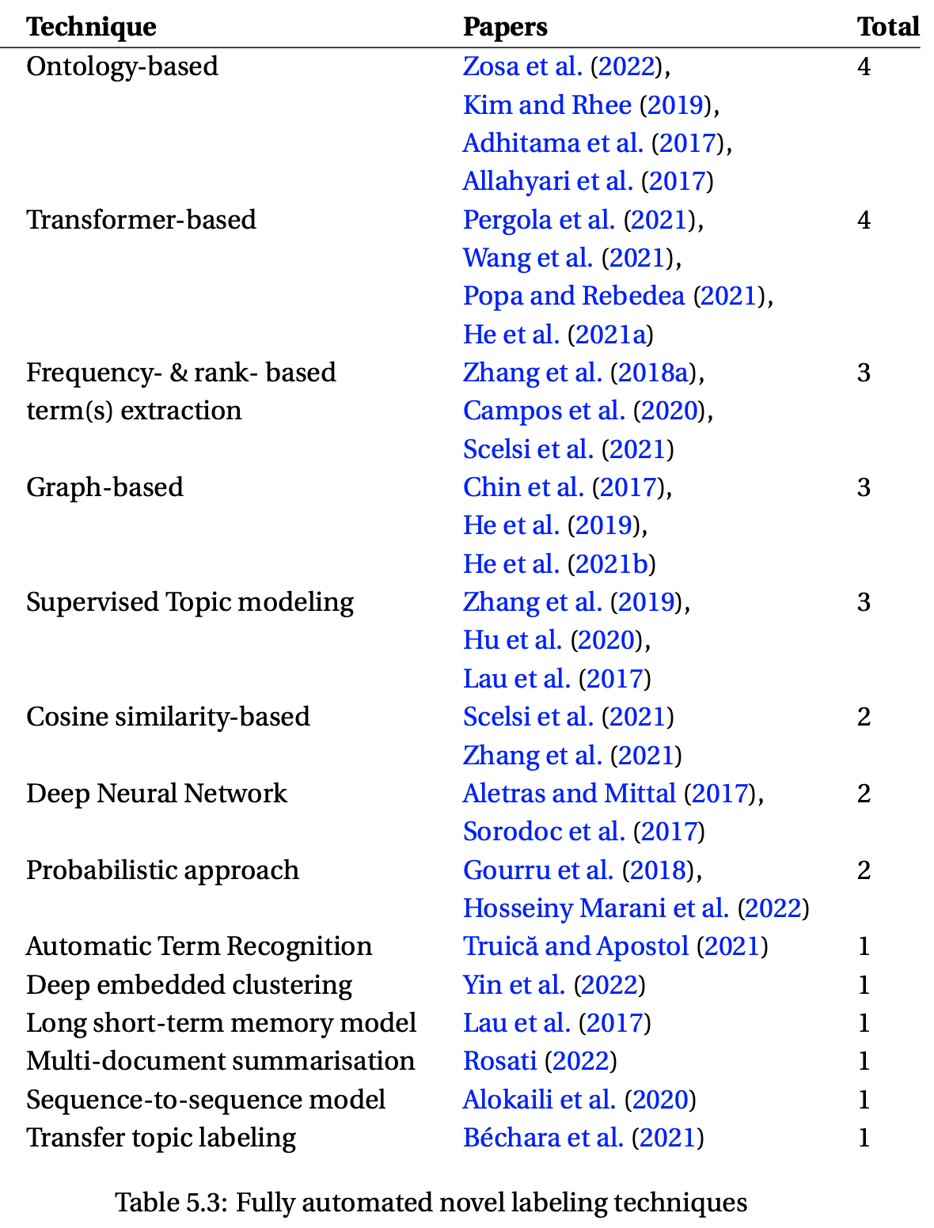
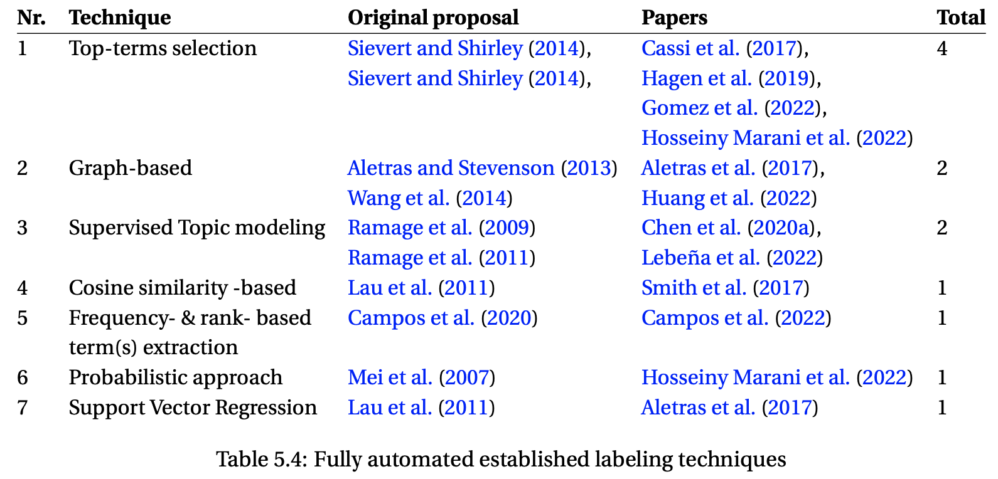
RQ1 – Labeling techniques & motivational context
Underlying techniques characterising the three macro-categories are explored
Fully automated approaches are found to be the most varied (showing 16 categories of techniques)
Motivating factors for employing labeling steps are also extracted
Providing a better characterisation of the analysed corpus
Producing more easily interpretable topics
Addressing the overhead of manual labeling
Assessing the interpretability of the topics

Slide 19
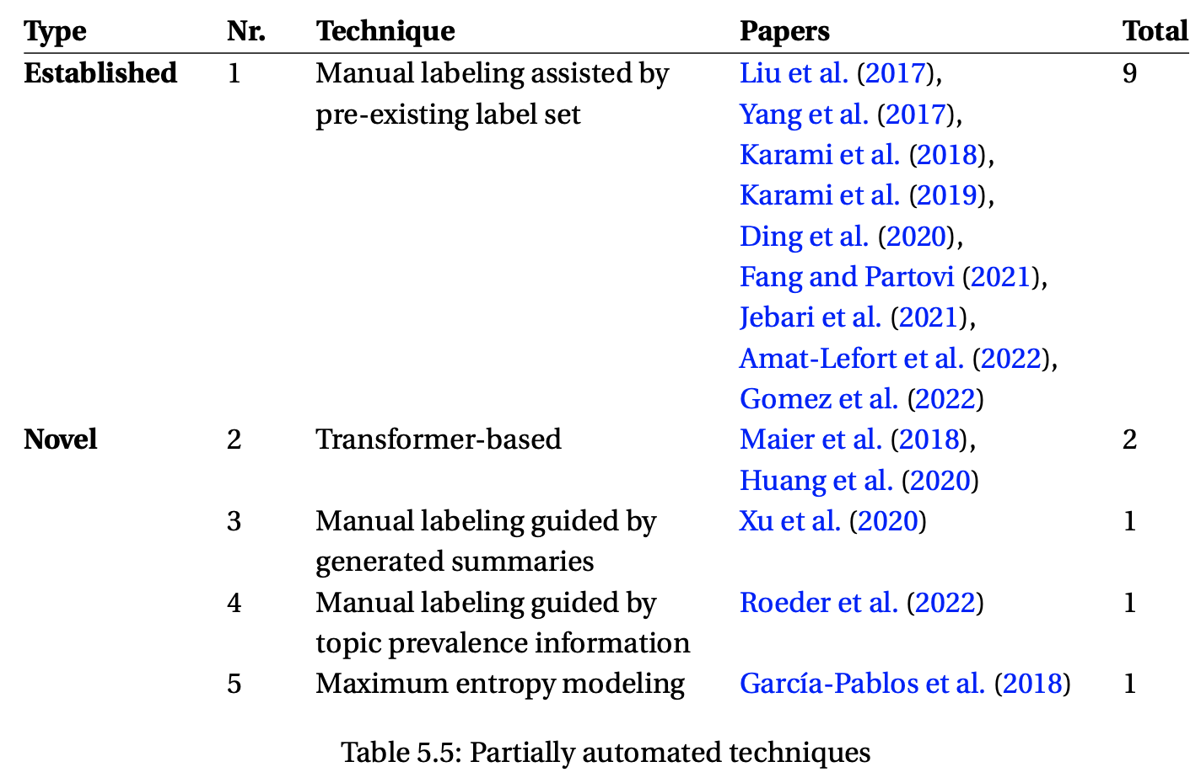
RQ1 – Labeling techniques
Partially automated approaches
Only two overarching techniques are identified for manual labeling approaches

Slide 20
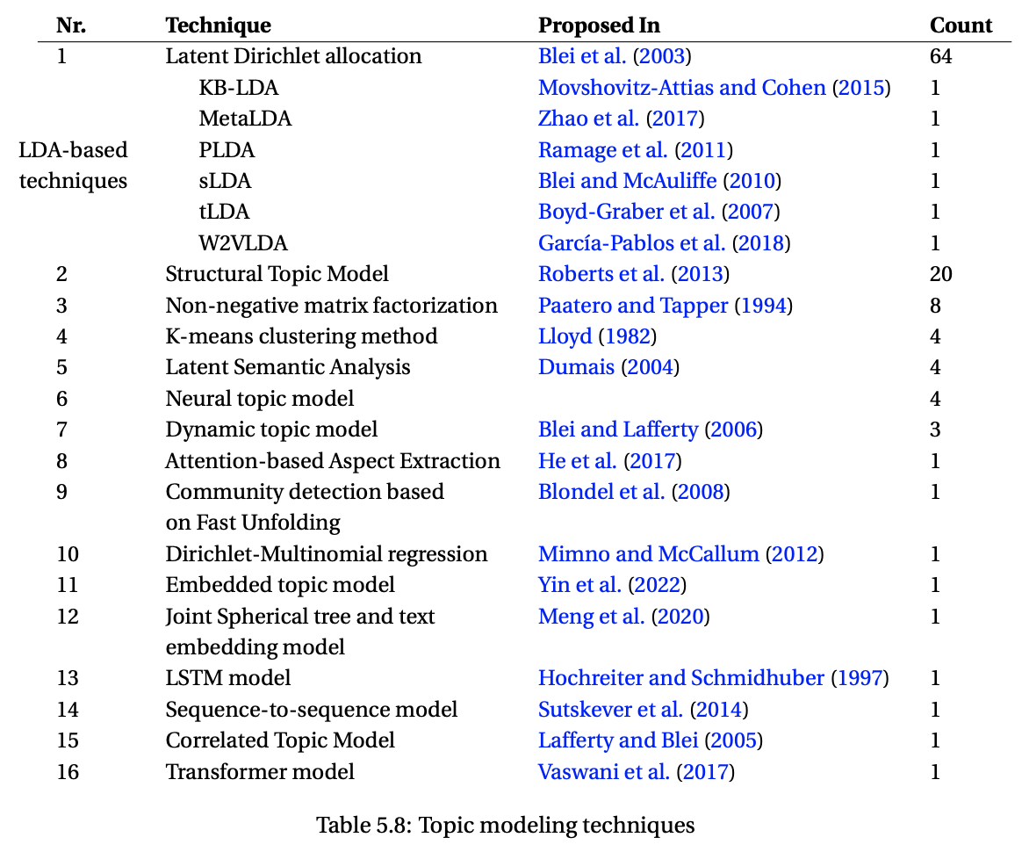
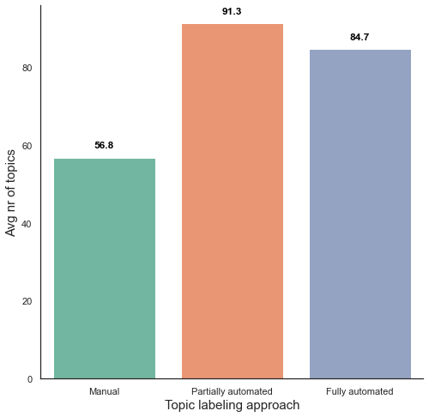
RQ2 – Topic modeling approaches
16 topic modeling approaches are identified
The number of generated topics is found to be higher for documents employing (partially/fully) automated labeling approaches
Notes:
STM is capable of incorporating document metadata (e.g. authors, publisher, date, etc.) into the generative process
documents making use of STM are found in the 86% of cases to be interested in “Characterising the corpus”
-
authors employing manual labeling might be less willing to experiment with the generation of an higher number of topics given the inherent bottleneck that such a manual approach would imply during the labeling phase

Slide 21
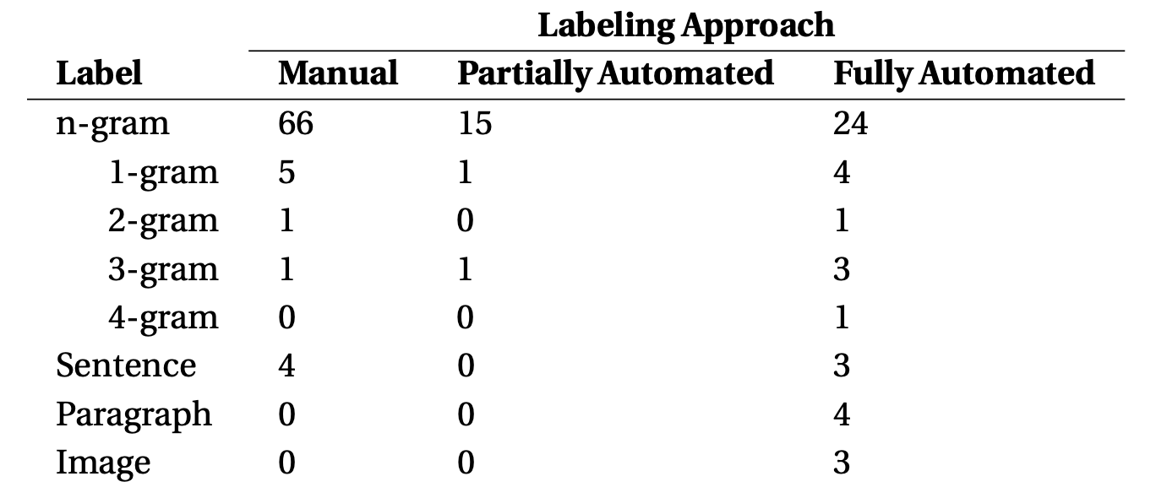
RQ3 – Label structures
4 distinct structures (i.e. label types) are observed
As expected, most studies employ phrase labels
Notes:
Notice that one document can potentially have more than one label type

Slide 22
RQ3 – Label quality evaluation
Quality evaluations are a relatively rare occurrence (found in ~20% of studies)
Human-based approaches
Four-level scales of relevance (“totally irrelevant” – “perfectly fitting”)
Binary evaluations (“unrelated” – “good”)
…
Automated approaches
Transformer-based (BERTScores)
Cosine similarity
…
The practice is almost only found in studies showing a primary focus on topic labeling
Notes:
Quality = Ability to effectively describe the topic
-
BERTSCORES, Cosine between generated and gold-standard / topic terms / related documents
Rogue1 = Overlap metric between label and terms
Cosine between label and gold-standard
Pointwise Mutual Information acts (in one study) as a measure of representativeness of the label for the corresponding distributions

Slide 23
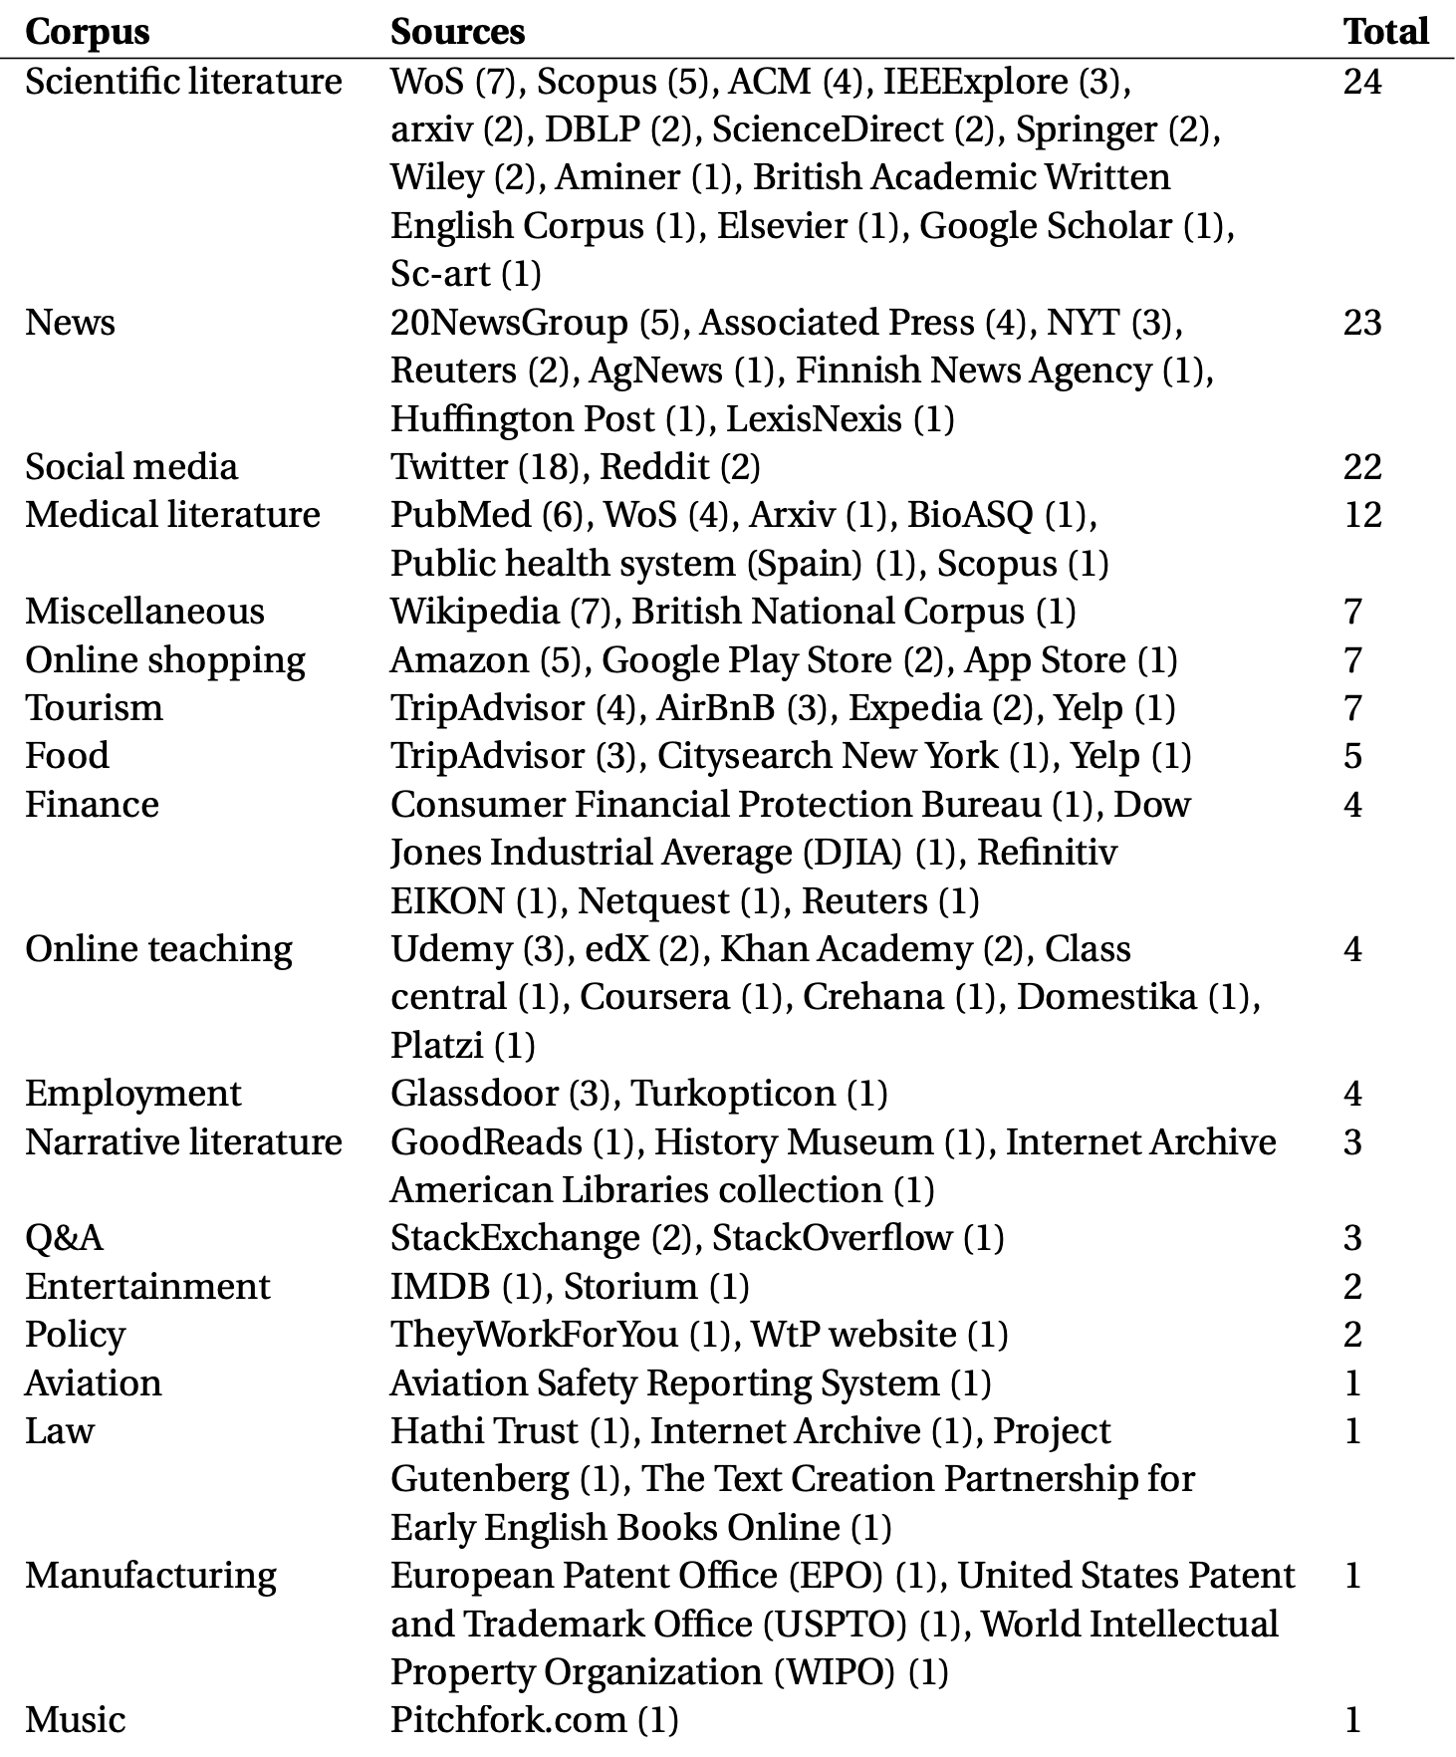
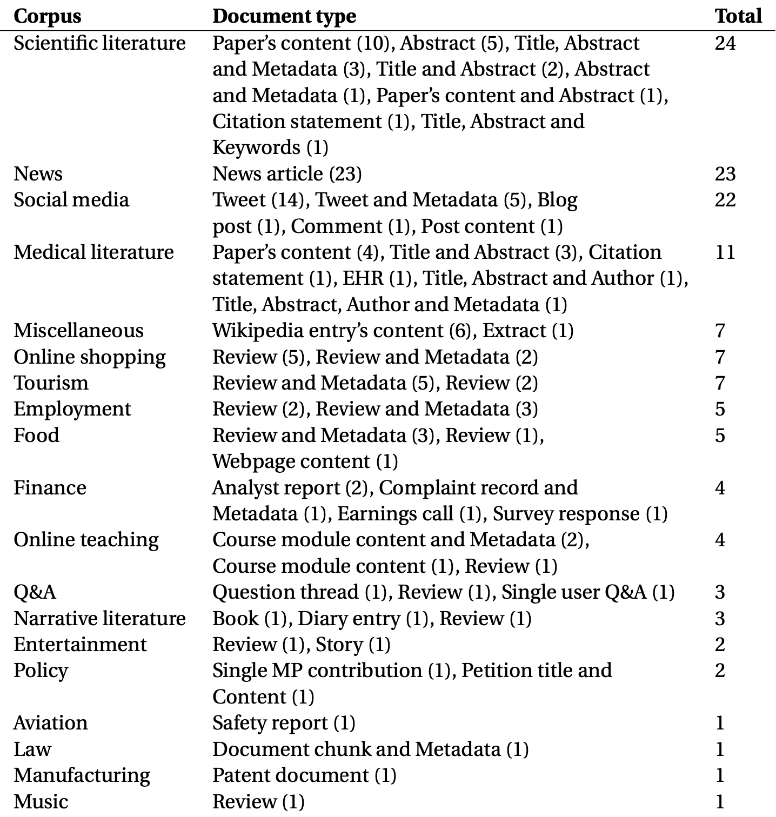
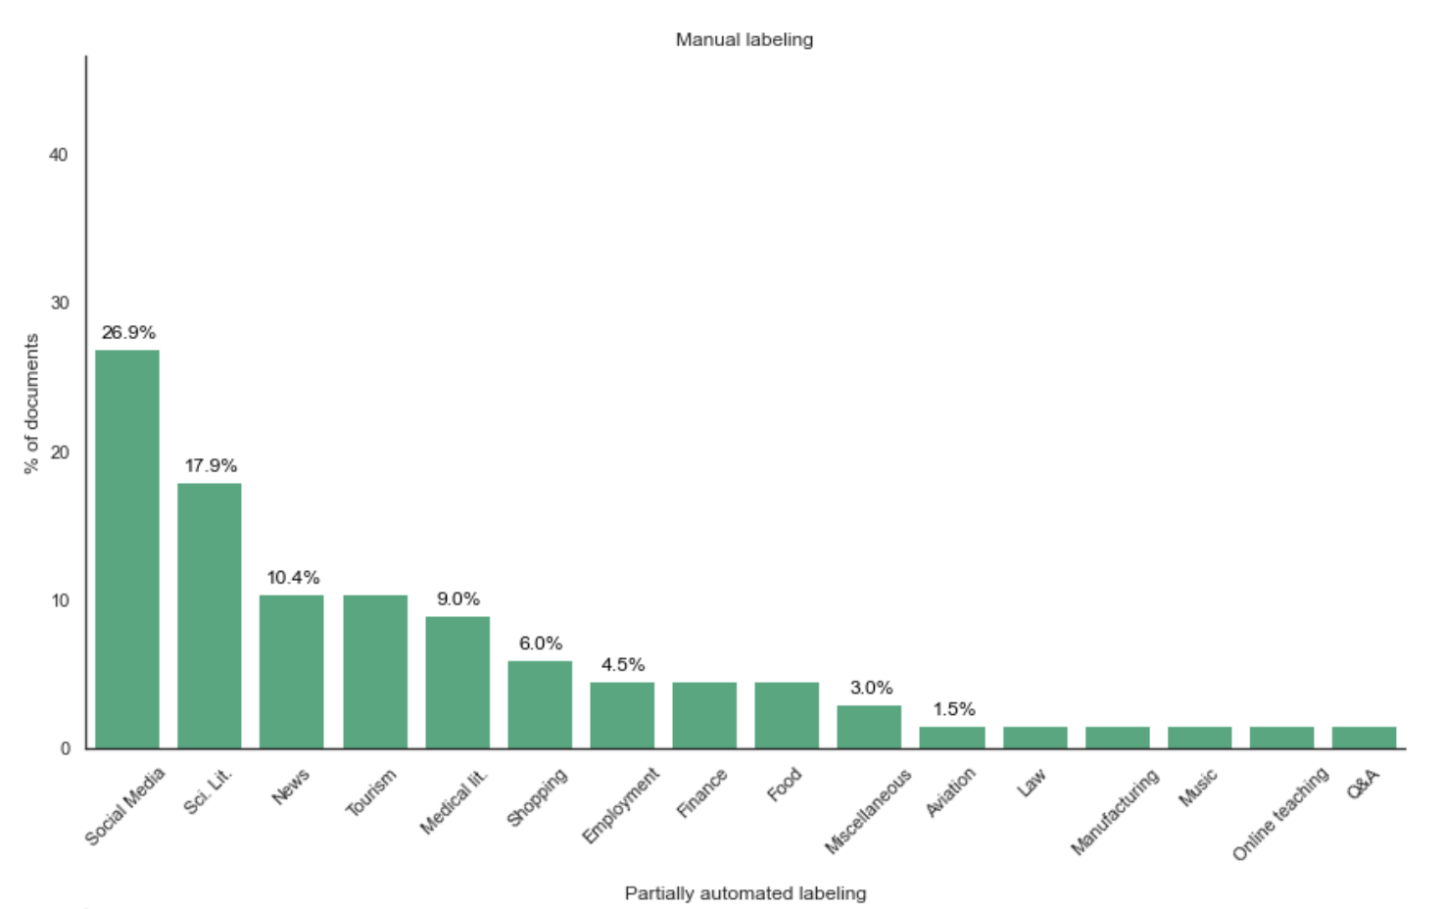
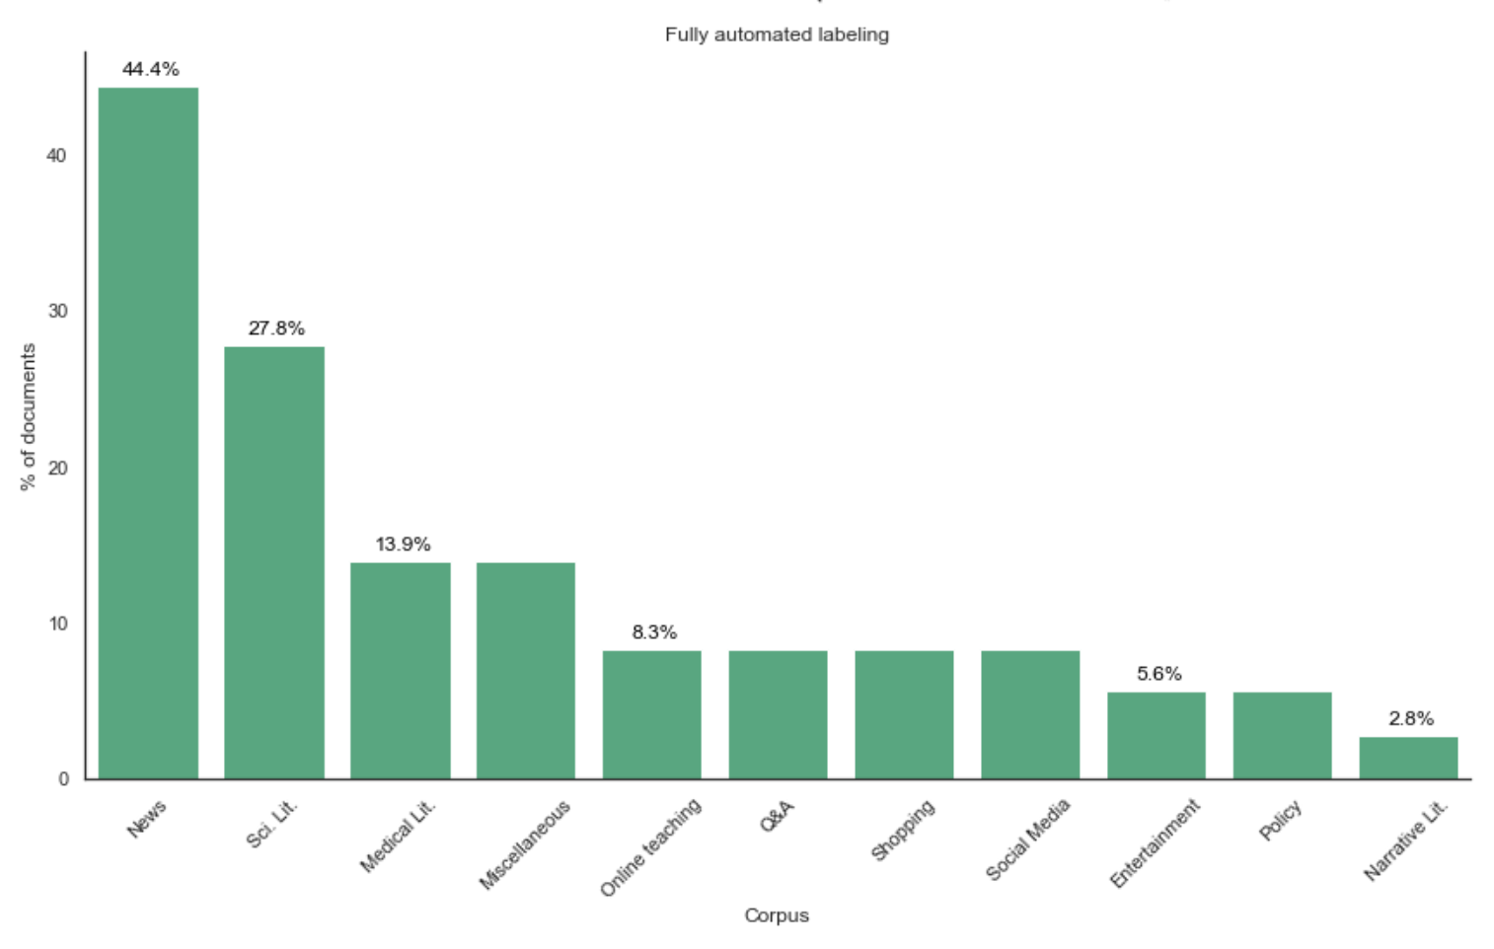
RQ4 – Categories of corpora
19 categories of corpora are identified
Notes:
are identified on the basis of the origin and focus of the documents
…. Also provides an overview on the prevalence of these different categories of corpora among the three labeling approaches

Slide 24
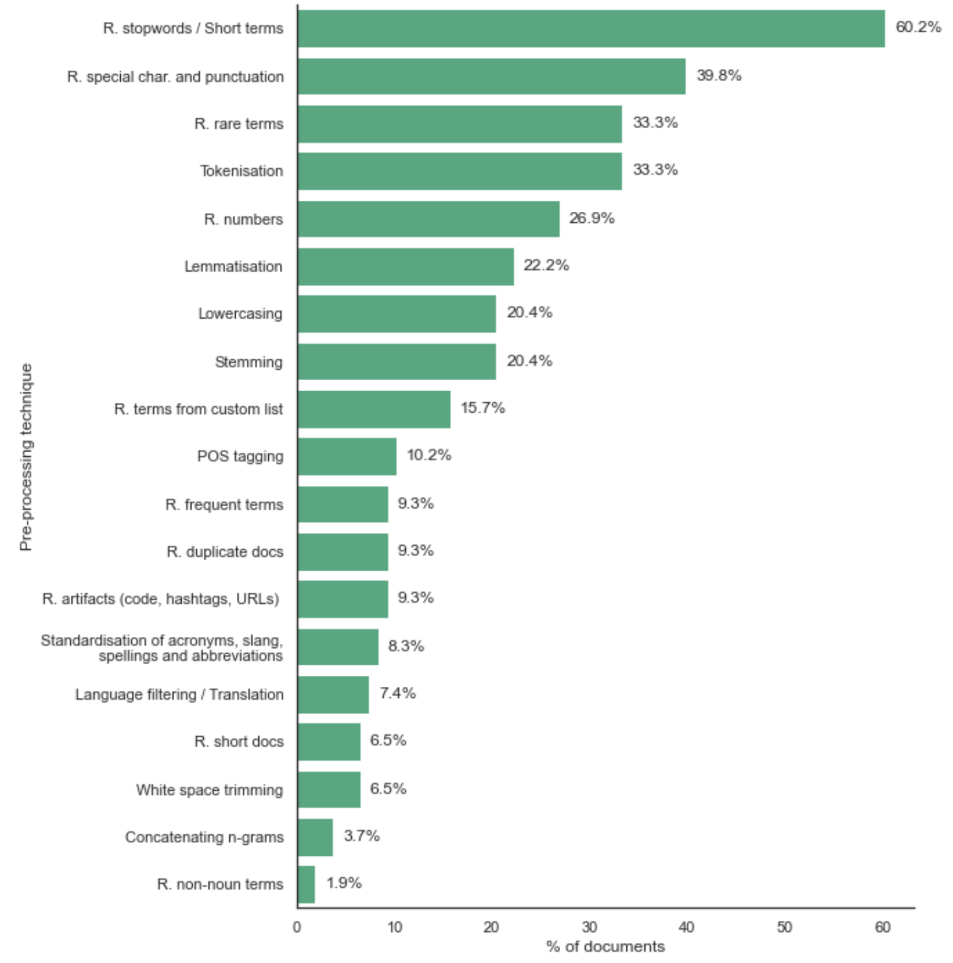
RQ4 – Pre-processing
Applied pre-processing steps are aligned with the observed modelling techniques

Slide 25
Research gaps
Identified gaps:
Proposed labeling methods lack follow-up applications in future research
Encountered quality evaluation procedures are found to have pitfalls
Evidence supporting the use of alternative label representations is lackluster
Recommendations to address them:
Make relevant code repositories accessible and supplement them with comprehensive documentation
Include more than one evaluation criteria when assessing label quality Involve domain experts to address concerns of bias and subjectivity tied to human evaluations …
Propose more than one type of representation for each collection of topics Employ domain knowledge to select the most appropriate label type for a given domain
Notes:
Pitfalls
1. Almost only conducted when having a primary focus on topic labeling
2. One criteria is used + one information type
3. Bias / subjectivity
4. Monodimensional evaluation (one factor) -> good fit vs bad fit

Slide 26
Gap 1 – Forward applications of labeling techniques
Are proposed approaches used in future research?
Forward search is conducted on (29) documents proposing fully automated approaches
Only 11 techniques are found to have forward implementations
In more than half of the cases, these play the role of baseline approaches
Additionally, some level of author overlap is fairly common in the future implementations
Availability of code repositories is found to hugely impact the reusability of a methodology
Almost all studies sharing their code also present subsequent applications
The opposite trend is observed for documents lacking such repositories
To address the gap, it is suggested to:
Make the relevant code repositories accessible and to supplement them with comprehensive documentation
Additionally, pointers to existing approaches are provided to prospective readers (Table 6.1 & Chapter 7)
Notes:
Only 11 are found to have forward implementations + They often represent a minority over the total citations
Baselines in 57% of cases
40% author overlap
14 of 19 without repositories do not have forward implementations + another 3 have author overlap

Slide 27
Gap 2 – Shortcomings in the quality evaluation procedures
Are there identifyiable shortcomings in the encountered quality evaluation procedures?
The interested (22) documents are inspected
Few (7) use more than one criteria for evaluation and even fewer (4) a mix of manual and automated approaches
With the exception of 2 documents, only one type of information is considered in each evaluation
Considerations are also made on the risk of bias and subjectivity in the evaluations involving human assessors
Evaluations are also tipically monodimensional (i.e. good fit vs. bad fit), with only 6 documents considering more than one factor in the assesment procedure
Ways to address this gap (mostly) logically follow…
Notes:
As previously stated -> Quality evaluation found in only 20% of documents
In most cases (17 studies),… + other 3 documents only have an informal evaluation
More than one factor -> (1) relevance\coverage\discrimination (2) how well the label fit gold-standard vs related terms (3) Suitable & Objectionable
Type of information -> topic terms, documents, other labels, gold-standard labels
-
More than one criteria = redundancy (i.e. guarantee of quality)
Bias/subjectivity -> Use domain experts
Multidimensional approach -> EFA -> Suitable / Objectionable, two factors involved in (human) judgement of the quality of topics

Slide 28
Gap 3 – Effectivness of alternative representations
Are alternative label representations more effective in summarising topics?
The (13) relevant documents are analysed. No formal evidence is found supporting non n-gram representations
Backward search is conducted, and additional (relevant) documents are collected
Paragraph labels show higher metrics of relevance, coverage and discrimination than n-gram counterparts - Wan and Wang (2016a)
Sentence labels are also shown to outperform (n-gram) baselines - Barawi et al. (2017)
Even with this further information, it is concluded that:
Currently, application of alternative label representations is limited
Additionally, research offering formal comparisons to phrase labels is severely lackluster
Ultimately, it is suggested that domain knowledge should still be applied when choosing the most appropriate representation for a given scenario
Notes:
Users are found to prefer labels that are “shorter on average” - Smith et al. (2017)
Whilst more quickly interpretable, images are shown to be substantially less effective at describing the content of the topic - Aletras et al. (2017)
Address the gap:
Produce multiple label representations
Strive to include formal comparisons among the different representations

Slide 29
Insights from individual studies
Notheworthy techniques are identified on the basis of:
The accessibility of the documents (Green & Gold Open Access)
The reusability of the described methodologies
Five approaches are identified:
Two (Scelsi et al., 2021, Zosa et al., 2022) draw label candidates from pre-existing pools (Thesaurus & Ontology)
Two (Alokaili et al., 2020, Popa and Rebedea, 2021) use deep neural networks (S2S & Transformer models)
One (Aletras and Mittal, 2017) generates image labels
Notes:
Findability, Accessibility, Interoperability, Reusability
The FAIR Guiding Principles for scientific data management and stewardship"
best practices designed to improve the reuse capabilities of scholarly data
-
Thesaurus-based -> Does not require training, weighted TFIDF of overlapping terms + Cosine similarity
Ontology-based -> Multilingual approach (uses SBERT embeddings fed through a trained NN) -> The NN predicts the P(concept | embedding) > t
Transformer-based -> BART-TL
Image-based -> VGG-net

Slide 30
Conclusions & Future work
In conclusion, this secondary study
Provides a (previously absent) overview of the existing research on topic labeling
Underlines three gaps that should be taken into account in future studies
Points prospective researchers towards existing (reproducible) labeling techniques
Includes methodological contributions conceptually applicable to other reviews
In terms of future work
Suitable processes for the evaluation (and inclusion) of grey literature could be established
The developed methodologies for constructing literature networks (Appendix D) can be exploited
Notes:
conceptually applicable to similar studies -> Secondary studies where previously existing reviews are absent
1. justifying extensions (meth contr)
2. limitations of my work

Slide 31
Thank you

Slide 32
Additional Slides

Slide 33
SEGRESS: Software Engineering Guidelines for REporting Secondary Studies
Built upon the PRISMA 2020 statement
Shares the same terminology and items
Provides definitions and examples for non-healthcare practitioners
Integrates guidelines for
Mapping studies (Tricco et al., 2018)
Qualitative reviews (Tong et al., 2021; Wong et al., 2013)
The proposed secondary study is structured around the relevant SEGRESS items
Notes:
PRISMA (Preferred Reporting Items for Systematic Reviews and Meta-Analyses) - Quantitative Reviews, Mixed-Method studies and Meta-Analyses
De-facto standard in healthcare domain
-
Planning -> Conducting -> Reporting

Slide 34
SLRs vs SMSs
Systematic Mapping Study
Provides a broad overview of a research area / field of interest
Explores characteristics of the studies, such as the study types and research methods
Can represent a starting point for the development of an SLR
Systematic Literature Review
Provides a summary of the relevant evidence
Explores contents of the studies, such as encountered techniques, findings and potential gaps in the research
"Systematic mapping studies are used to structure a research area, while Systematic Reviews are focused on gathering and synthesizing evidence" – Petersen et al. (2015)
Notes:
Research methods -> Dataset was created or an existing one was used, same thing for models, participants were involved

Slide 35
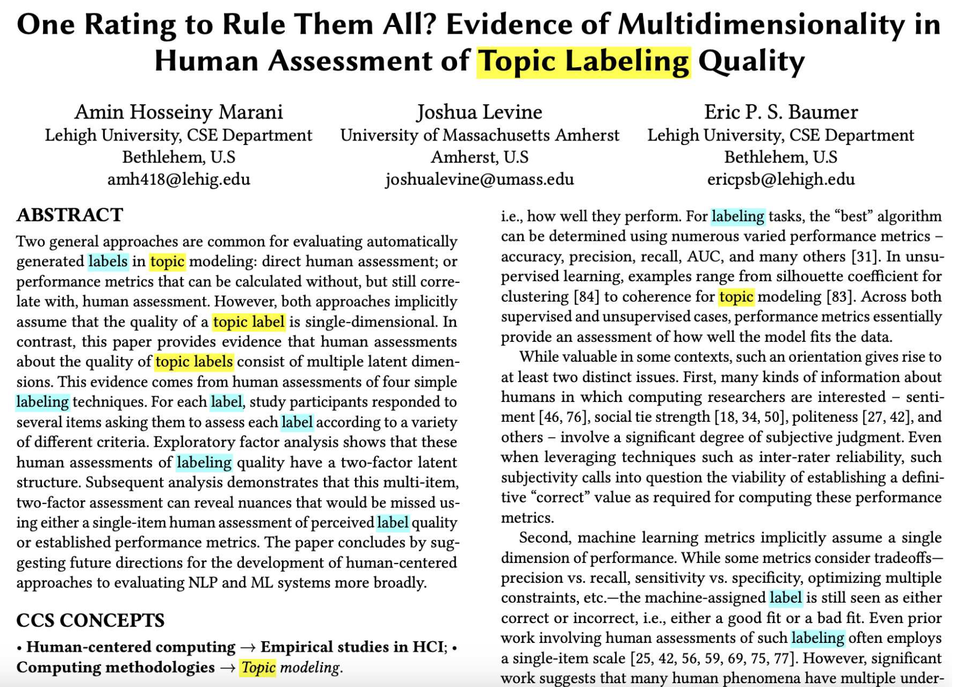
Data collection process
External tools are exploited to highlight salient portions of the inspected work
Notes:
Integrate this image

Slide 36
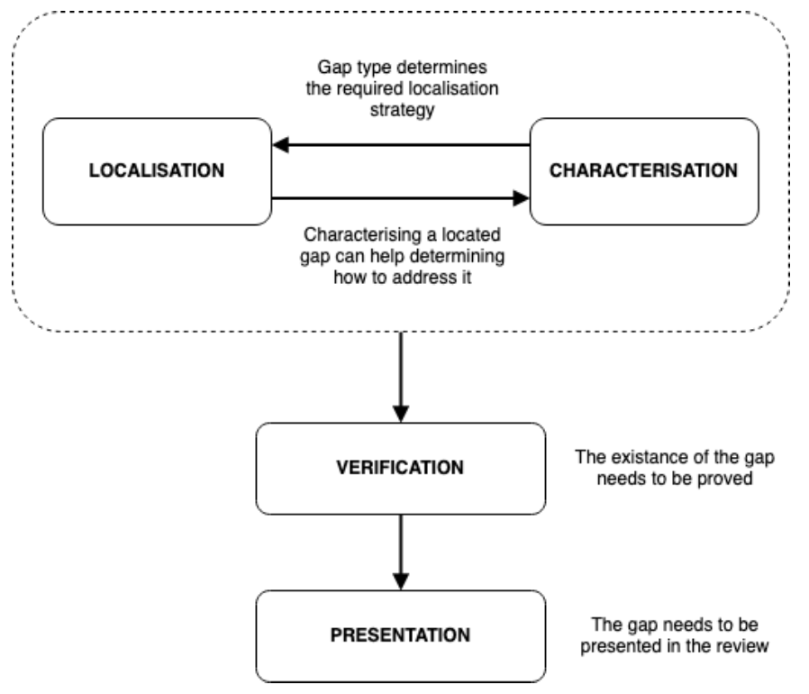
Framework for identifying gaps
- Mueller-Bloch and Kranz (2015)

Slide 37
FAIR questions
Findability
Are the relevant resources made available by the authors?
If that is the case, are they linked from the primary study or from the repository in which the study is hosted?
If that is not the case, is the resource unambiguously identifiable by querying specialised registries or dedicated repositories?
Accessibility
Can the resources be freely accessed?
Is the hosted resource still retrievable (i.e. inspectable and downloadable)? If that is not the case, has the associated metadata being persisted?
Additionally, are there specific requirements in place for execution (High-performance machinery, paid registration, proprietary software etc.)?
Interoperability
Are required dependencies (and associated versions), input and output data formats, communication interfaces and deployment options specified in the provided metadata?
Are there concerns associated with portability (e.g. specific OS requirements)?
Reusability
Can the resource be used with data distinct from the test one?
Is it conceptually possible to extend the provided resource? Is the provided usage license compatible with this possiblity?
Notes:
The FAIR Guiding Principles for scientific data management and stewardship
Towards FAIR principles for research software
best practices designed to improve the reuse capabilities of scholarly data

Slide 38
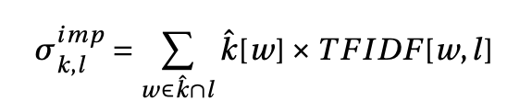
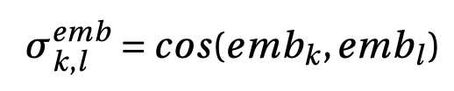
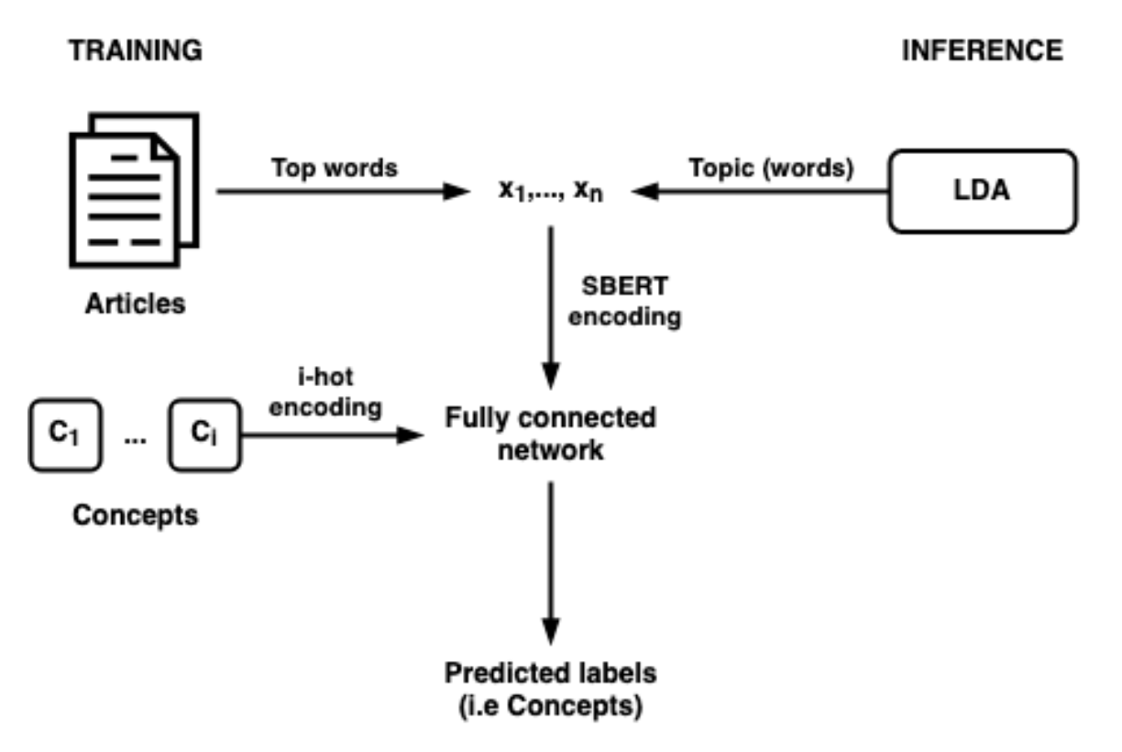
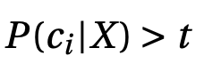
Details of selected insights
Thesaurus-based approach
Ontology-based (multilingual) approach
Fully connected network computes
Concepts where are selected
Selected concepts are propagated to the top of the ontology
Most frequently occurring concepts are selected as the label source
Notes:
Importance-based and embedding based labeling
IDF = log(N docs / N docs with term)
Each concept has identifiers in multiple languages

Slide 39
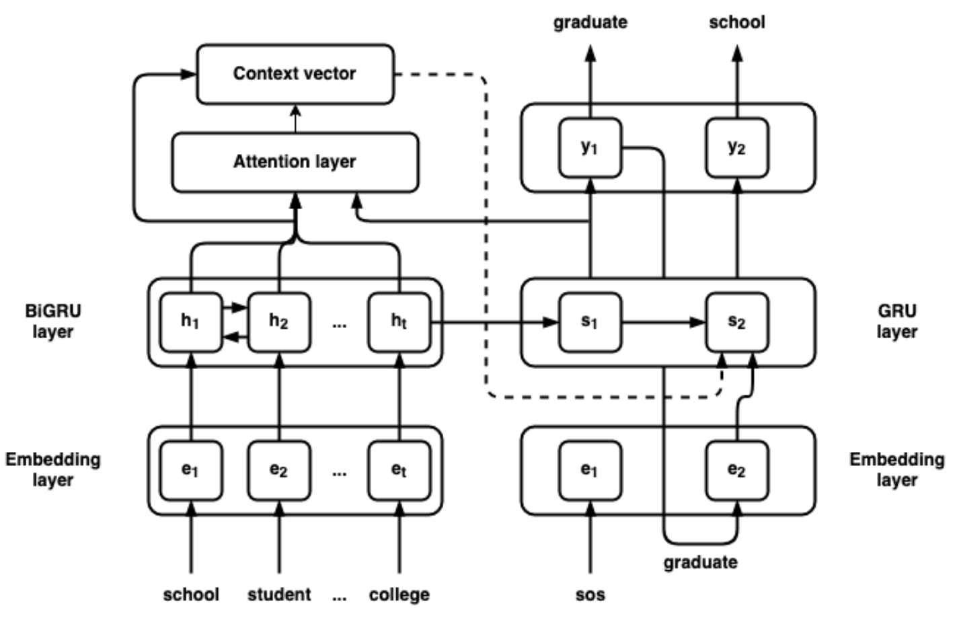
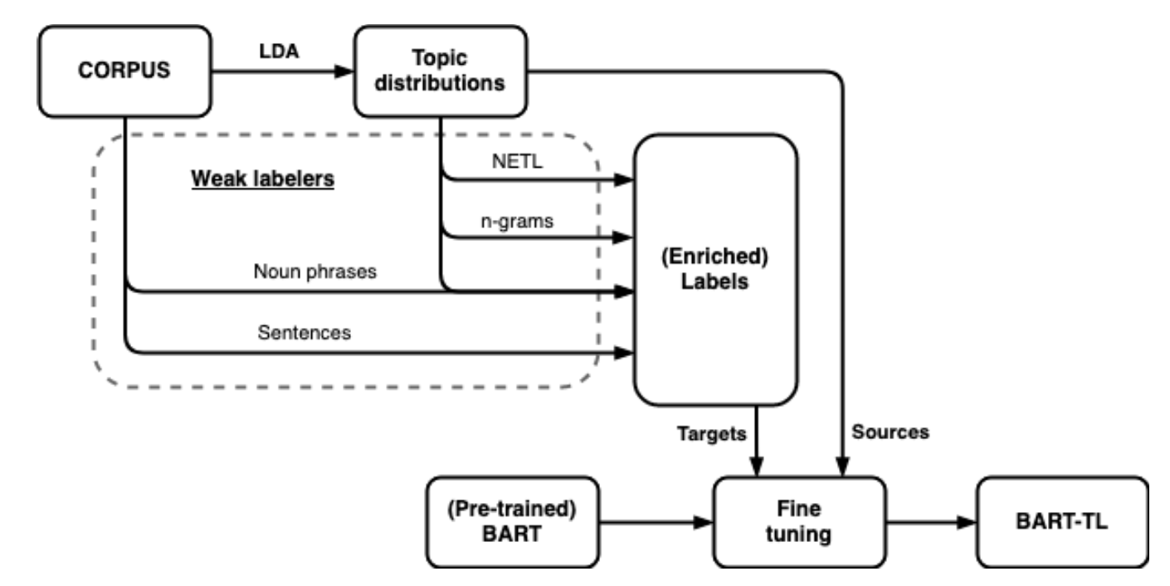
Details of selected insights
S2S approach
A dataset of synthetic topics is used to train the model
Transformer-based approach
Notes:
two RNN encoder-decoder structure
Topics extracted from wikipedia using the top words (tfidf)

Slide 40
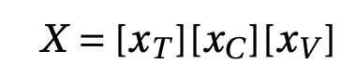
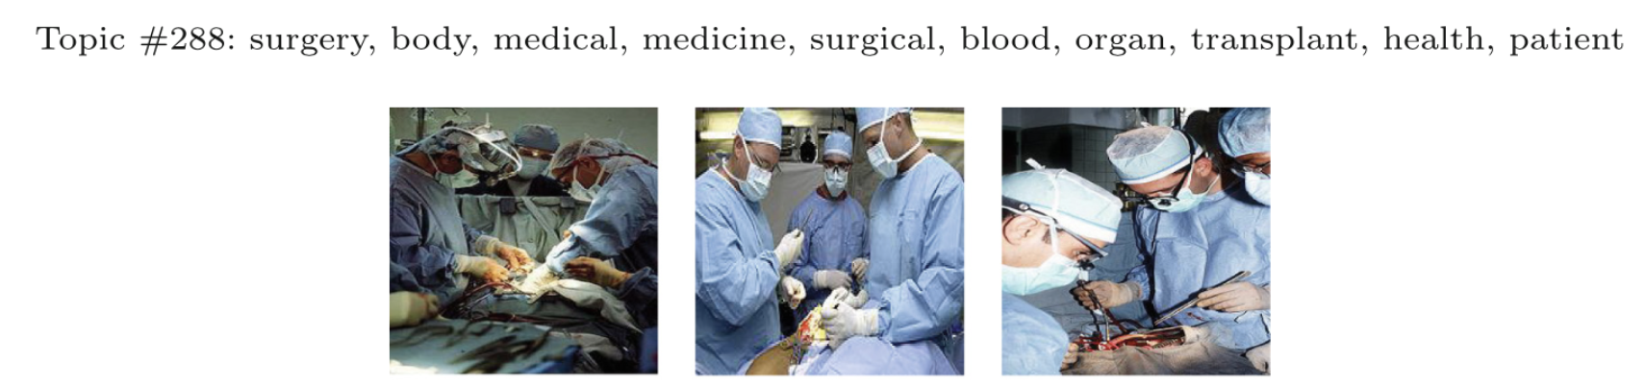
Details of selected insights
Image-based approach
Neural network receives as input a 1600-dimensional vector (X) made up of:
The topic embedding
The image captions embedding
The image vector computed using the VGG-net network
A dataset of topics each associated with 40 candidate images is used for training and testing
Notes:
In the dataset each topic-image is assigned a score (generated by human assessors)

